Slide 1

Introduction to Algorithms
Course Instructor:
Sumaiya Tasnim
Lecturer, Department of CSE
Varendra University

Slide 2
Acknowledgement
Dr. Md Nakib Hayat Chowdhury
Head, Department of CSE
Bangladesh Army University of Science and Technology (BAUST)
Mosiur Rahman Sweet
Former Lecturer, Department of CSE
Varendra University
Md. Muktar Hossain
Lecturer, Department of CSE
Varendra University

Slide 3
Why study Algorithms?

Slide 4

Professor Donald E. Knuth stated
“Computer Science is the study of algorithms”
Programs will not exist without algorithms...

Slide 5
What is an Algorithm?

Slide 6
“An Algorithm is
a Set of
Well-defined Instructions
in Sequence
to Solve a Problem.”

Slide 7
An algorithm is a tool for solving a well-specified computational problem. It is a sequence of computational steps that transform the input into the output.
An algorithm is said to be correct if, for every input instance, it halts with the correct output.
An incorrect algorithm might not halt at all on some input instances, or it might halt with other than the desired output.

Slide 8
Algorithms did not start with Computers,
they have been with us since ancient time;
nor they are limited to Computer Science…

Slide 9
Characteristics of Algorithm:
Unambiguous
Algorithm should be clear and unambiguous. It must lead to only one meaning.
Input
Algorithm should have 0 or more well-defined inputs.
Output
Algorithm should have 1 or more well-defined outputs and should match the desired output.

Slide 10
Characteristics of Algorithm:
Finite
An algorithm must terminate after a finite number of steps.
Feasible
An algorithm should be feasible with the available resources.
Independent
Algorithm should have step-by-step directions which should be independent of any system.

Slide 11
Algorithm VS Program:
Algorithm | Program
An algorithm is a set of well-defined instructions in sequence to solve a problem. | A program is an implementation of an algorithm to be run on a specific system.
It does not deal with machine specific details. | It deals with machine specific details.
Algorithm is written using natural language. | Programs are written using a specific programming language.
Think of it as a class. | Think of it as a object of the class.

Slide 12
Algorithm Design:
Design: Focuses on creating algorithms to solve a specific problem.
Understanding the Problem
Choosing a Strategy
Developing the Algorithm
Verification

Slide 13
Algorithm Design Techniques /Methods/Strategies/Approaches

Slide 14
Algorithm Design Techniques:
Exhaustive Search or Brute-Force Search
Backtracking, Branch and Bound
Greedy Method
Divide and Conquer
Dynamic Programming
Machine Learning
Randomized Algorithm
Online algorithm and offline algorithm

Slide 15
How to Design an Algorithm?
The problem that is to be solved by this algorithm i.e. clear problem definition.
The constraints of the problem must be considered while solving the problem.
The input to be taken to solve the problem.
The output is to be expected when the problem is solved.
The solution to this problem is within the given constraints.

Slide 16
How to Analyze an Algorithm?
The analysis focuses on determining the correctness of an algorithms and evaluating the performance of an algorithm.
Correctness
Complexity Analysis
Best/Worst/Average Case Analysis
Comparative Analysis

Slide 17
Analysis of an Algorithm: Correctness
A correct algorithm yields the correct result for all legal input values.
?
Proving the correctness of an algorithm is not at all an easy task.
It consists of two steps:
Proving that the algorithm will always terminate.
Proving that it will always produce correct result.

Slide 18
Analysis of an Algorithm: Performance
Two main concern: Time and Space
We actually do not count the time!
We count the number of steps!!
The lesser the number of steps, the faster the algorithm.
Space?

Slide 19
Complexity Analysis:
Two factors (time and space) define the efficiency of an algorithm.
Time Complexity: Refers to the amount of time required by the algorithm to execute and get the result.
T (P) = C + V
Constant Time Part (C): Any instruction that is executed just once comes in this part.
Variable Time Part (V): Any instruction that is executed more than once, say n times, comes in this part.
Calculating exact complexity is difﬁcult to deal with precisely because the details are very complicated. It is easier to talk about upper and lower bounds of the function.

Slide 20
Complexity Analysis:
Two factors (time and space) define the efficiency of an algorithm.
Space Complexity: Refers to the amount of memory required by the algorithm to store the variables and get the result.
S (P) = C + V
Fixed Part (C): The space that is required by the algorithm.
Variable Part (V): The space that can be different based on the implementation of the algorithm. For example, temporary variables, dynamic memory allocation, recursion stack space, etc.

Slide 21
Representing an Algorithm

Slide 22
Pseudocode
Pseudo is from the Greek word “psevdes” meaning false.
It is a high-level way of representing an algorithm by annotations and informative text written in plain English.
It has no syntax like any of the programming language and thus can’t be compiled or interpreted by the computer.
r.
Notes:
`

Slide 23
Pseudocode Conventions
Give a valid name for the pseudocode procedure.
Use line numbers for each line of code.
Use proper indentation for every statement in a block structure
For flow control statements use if-else. Always end an statement with an end-if. Both if, else and end-if should be aligned vertically in same line
Use “=“ or “←” operator for assignment statements
r.
Notes:
`

Slide 24
Pseudocode Conventions
Array elements can be represented by specifying the array name followed by the index in square brackets.
Example: A[i] indicates the ith element of array A
For looping or iteration use for or while statements. Always end a for loop with end-for and a while loop with end-while.
The conditional expression of for or while must maintain same indentation.
r.
Notes:
`

Slide 25
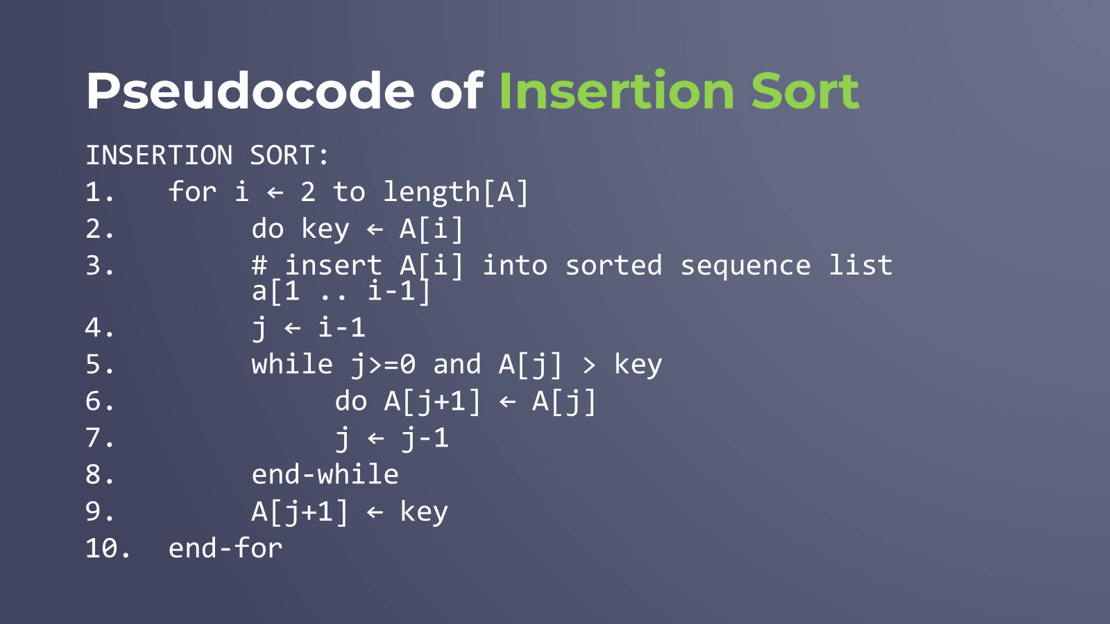

Slide 26
Flowchart
Flowchart refers to diagrammatic representation that illustrates a solution model to a given problem.
It is a visual representation of an algorithm which describes graphically in detail the logical operations and steps of the algorithm.
r.
Notes:
`

Slide 27
Flowchart Convention
Symbol | Purpose | Description
 | Flow Line | Indicates the flow of logic by connecting symbols.
 | Terminal | Represents the start and the end of a flowchart.
 | I/0 | Used for input and output operation.
 | Processing | Used for arithmetic operations and data-manipulations.
 | Decision | Used for decision making between two or more alternatives.
https://www.gliffy.com/blog/how-to-flowchart-basic-symbols-part-1-of-3

Slide 28
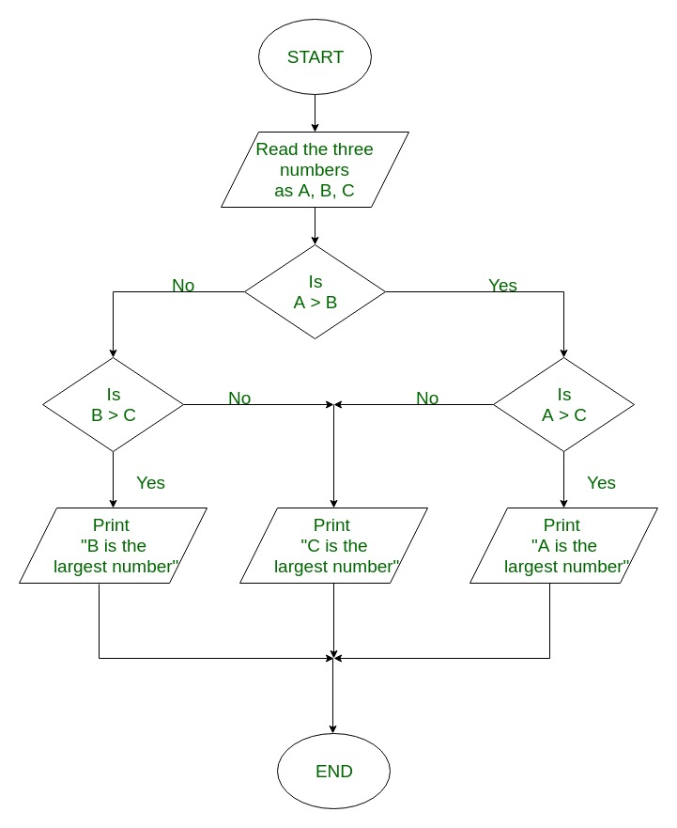
Flowchart Example
flowchart to find largest of 3 numbers

Slide 29
Flowchart of Insertion Sort
Key = A[i]
J = i-1
Start
Read An Array(A)
Is j>=0 and A[j] > key ?
true
Len = Length of A i = 2
false
A[j+1] = key
i = i+1
A[j+1] = A[j] j = j-1
Is i<Len?
true
false
End

Slide 30
"Students shouldn't go out into life without the ability to communicate. Your success in life will be determined largely by:
-your ability to speak,
-your ability to write &
-the quality of your ideas,
in that order.“
— Late MIT Prof. Patrick Winston

